Slide 1
Introduction to Event-Driven Programming and Events & Listeners
Lecture 18
Key Concepts and Examples

Slide 2
What is Event-Driven Programming?
Definition: Event-Driven Programming is a paradigm where the flow of the program is determined by events such as user actions, sensor outputs, or messages from other programs.
Key Characteristics:
Focuses on responding to events like clicks, keystrokes, or system-generated signals.
Common in Graphical User Interfaces (GUIs) and real-time systems.
Examples:
Clicking a button in a GUI.
Pressing a key on the keyboard.
Receiving a network message.

Slide 3
Components of Event-Driven Programming
Events:
Actions or occurrences that trigger code execution.
Examples: Button clicks, mouse movements, window resizing.
Event Sources:
Objects that generate events.
Examples: Buttons, text fields, sliders, and other GUI components.
Event Listeners:
Interfaces or methods that respond to events.
Example: A method that runs when a button is clicked.

Slide 4
Key Concepts - Events & Listeners
Events: Represent an action or change of state. For example:
ActionEvent for button clicks.
MouseEvent for mouse interactions.
KeyEvent for keyboard presses.
Listeners: Objects that "listen" for events and execute appropriate code.
Example: ActionListener for button click events.

Slide 5
Commonly Used Event Listeners
ActionListener: Listens for action events (e.g., button clicks).
MouseListener: Listens for mouse events like clicks and hovering.
KeyListener: Listens for keyboard input events.
WindowListener: Listens for window events like opening and closing.

Slide 6
Basic Workflow in Event-Driven Programming
Create Event Source: Add GUI components (e.g., buttons, text fields).
Attach Listener to Source: Register a listener object with the source.
Handle Events: Define methods in the listener to specify what happens when the event occurs.

Slide 7
Example: Button Click Event
import javax.swing.*;
import java.awt.event.*;
public class ButtonClickExample {
public static void main(String[] args) {
JFrame frame = new JFrame("Button Click Example");
JButton button = new JButton("Click Me");
button.addActionListener(new ActionListener() {
@Override
public void actionPerformed(ActionEvent e) {
System.out.println("Button clicked!");
}});
frame.add(button);
frame.setSize(300, 200);
frame.setDefaultCloseOperation(JFrame.EXIT_ON_CLOSE);
frame.setVisible(true);
} }

Slide 8
Advantages of Event-Driven Programming
Interactive Applications: Provides a natural way to create user-friendly interfaces.
Modularity: Separates event logic from the main application logic.
Extensibility: Easy to add or modify event handlers without disrupting other parts of the program.

Slide 9
Real-Life Example
Scenario: ATM System
Event: User inserts a card (event triggered).
Event Source: Card reader.
Listener: Code that validates the card and displays the menu.

Slide 10
Summary
Event-Driven Programming enables interactive applications.
Events are actions like clicks, keystrokes, and mouse movements.
Listeners are used to define responses to these events.
Key Takeaway: Mastery of events and listeners is essential for building dynamic and responsive GUI applications.

Slide 11
Home Automation System
A home automation system enables users to control various appliances like lights, fans, and air conditioners through an interactive graphical interface. Events like button clicks or slider adjustments trigger actions such as turning devices on/off or adjusting their settings.
This system demonstrates the concept of event-driven programming where user actions (events) initiate corresponding responses.
Scenario Implementation:
Goal: To create a home automation GUI with the following functionality:
Turn lights and fans ON or OFF using buttons.
Adjust air conditioner temperature using a slider.

Slide 12
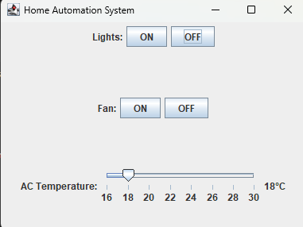
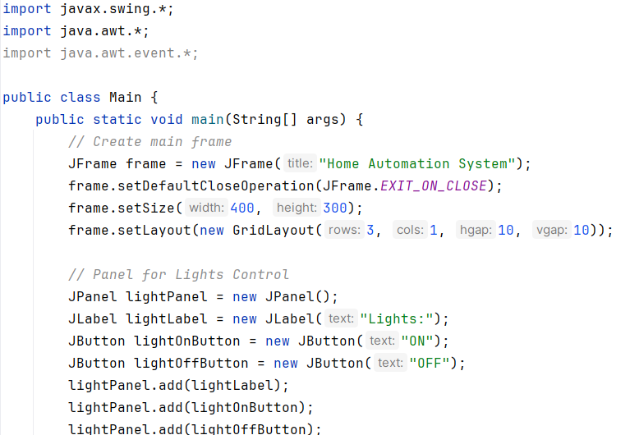
Code Implementation in Java:

Slide 13
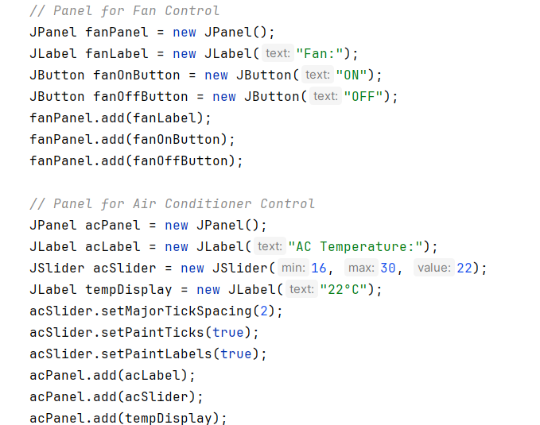
Code Implementation in Java:

Slide 14
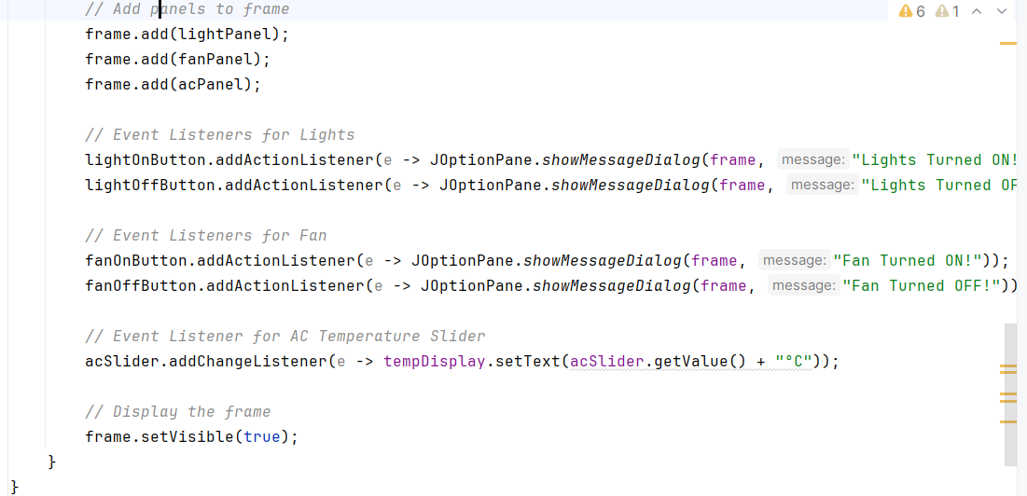
Code Implementation in Java:

